Slide 1
Introduction to Digital Rights Management (DRM)
Multimedia Security

Slide 2
Outline
Digital rights management: an overview
Digital watermarking
  Basics and models
  Trends and challenges
Cryptography in DRM
Digital rights languages
Important DRM standards
Legislative concerns about DRM
DRM researches in CML

Slide 3
Digital Rights Management:
An Overview

Slide 4






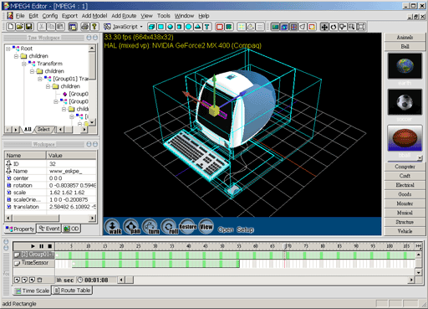


Why Content Protection Is a Must?
Digital technologies facilitate new experiences for content users in consuming, authoring, replicating and delivery of digital contents. However, prevalence of digital replication devices and explosive growth of Internet usages also result in serious copyright infringement problems at the same time.

Slide 5





What is DRM?
A DRM system enables the secure exchange of intellectual property, such as copyright-protected music, video, or text, in digital form over the Internet or other electronic media, such as CDs, removable disks, or mobile networks
DRM
Creator
Publisher
Aggregator
Distributor
Retailer
Consumer
DRM is the chain of hardware and software services and technologies governing the authorized use of digital content and managing any consequences of that use throughout the entire life cycle of the content

Slide 6





Content Protection Technologies
Content Protection
Enforcement
Law
Business
Technology
Education
Digital Rights Management
Copy
Control
Author Identification
Credential Authentication
Conditional Access
Integrity Checking
Usage Rule Specification
Inter-operability
Watermarking
Cryptography
Rights Languages
Robust watermarking
Cryptographic protocols
Hash
XrML
Fragile watermarking
Symmetric ciphers
Digital Signatures
ODRL
Visible watermarking
Asymmetric ciphers
MPEG REL
Fingerprinting

Slide 7
The DRM Reference Architecture
Content Server
Client
Content
Repository
Content
Package
DRM
Packager
Content
Product
Information
Metadata
Rendering
Application
License Server
DRM
Controller
Rights
DRM License
Generator
Identity
License
Encryption
Keys
Keys
Identities
Rights
Three major components of the DRM reference architecture

Slide 8
DRM Events
Content Server
Client
Content
Repository
Content
Package
DRM
Packager
(1) Obtaining the
content package
Content
Product
Information
Metadata
Rendering
Application
(2) Activating the DRM controller
License Server
DRM
Controller
(9) Decrypting the content and
releasing it to the rendering application
(7) Generating the license
Rights
DRM License
Generator
(3) Sending info to
the License Server
(5) Look up
rights info.
(8) Sending back the license
Identity
License
(4) Authenticating the
client’s identity
Encryption
Keys
Keys
Identities
Rights
(6) Financial transactions
The DRM controller on the client side has to check the rendering application at some time
  To avoid making unauthorized copies
  To check certain rights limits

Slide 9
Digital Watermarking
Technologies

Slide 10
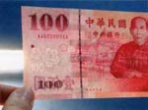
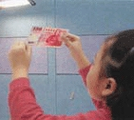



What is Watermarking?
Traditional Watermarking
Watermarking is traditionally an important mechanism applied to physical objects, such as bills, papers, garment labels, product packing.
The watermark is hidden from view during normal use, and only become visible by adopting a special viewing process.
The watermark carries information about the object in
which it is hidden
Digital Watermarking (Robust Invisible Watermarking)
Fidelity
Embedding Module
Processing/ Attacks
Extraction Module
Original Content
Marked
Content
Marked
Content
Original Content
Capacity
Comparison
Robustness
Watermark to Embed
Extracted Watermark

Slide 11
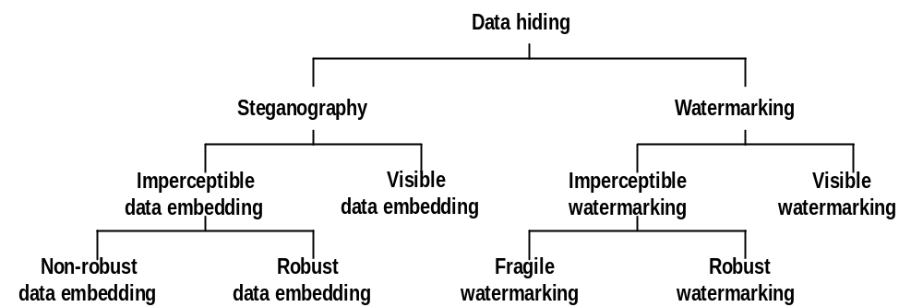
Data Hiding, Watermarking and Steganography

Slide 12


Desired Properties of Watermarking
Capacity
High fidelity
  Finding adequate perceptual quality index is still an open problem
  Objective distortion measures are often adopted
Strong robustness
  Robustness is difficult to define
  Benchmarks testing various attacks exist
Large capacity
  Required payload length depends on the purpose of different applications
Blind detection
  Original content is not required in detection side
  Non-blind detection limits the applicability of watermarking schemes
Low computation complexity
  Manufacturing cost and time constraints are important concerns
Fidelity
Robustness

Slide 13




Importance of Watermarking
Cryptography vs. Digital Watermarking
Before Protection
Protected
Without Protection
Encryption
Encryption
Decryption
:
Before Protection
Protected
Watermarking
Detector
© 2004 bh
Embedding
:
Detector
© 2004 bh
© 2004 bh
Various Applications of Digital Watermarking Technologies
Owner identification
Proof of ownership
Broadcast monitoring
Transaction tracking
Content authentication
Copy control
Device control
Metadata Association

Slide 14
Owner Identification (I)
Under the U.S. law, although the copyright notice is not required in every distributed copy to protect the rights of copyright holders, the award to the copyright holders whose work is misused will be significantly limited without a copyright notice found on the distributed materials.
Traditional textual copyright notices
  “Copyright date owner”
  “© date owner”
  “Copr. date owner”
Notes:
Open a PowerPoint “about” box to show copyright notice

Slide 15
Owner Identification (II)
Disadvantages for textual copyright notices
  Easily removed from a document when it is copied
    E.g. the Lena Sjooblom picture (see the next slide)
  Copyright notices printed on the physical medium are not copied along with the digital content
    E.g. the Music CD
  Occupying a portion of the image and aesthetically reducing the value of artworks
Since watermarks are imperceptible and inseparable from the work, they are obviously superior to textual copyright notices.

Slide 16

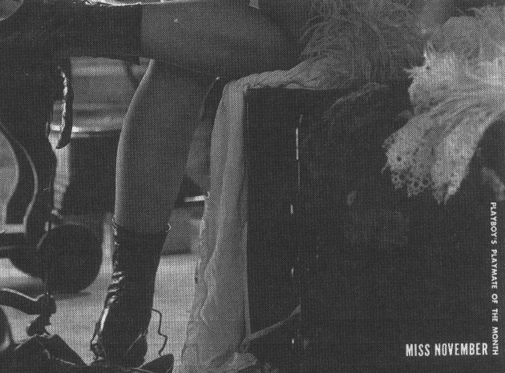
The Story of Lena
Lena is the most common test image in image processing research!
However, the copyright notice of this picture was cropped and ignored.
Notes:
Lena is the Miss November in the 1972 Playboy magazine.
In the 1973, USC students scan this page and using in image processing papers.
If a copyright notice robust to cropping is used, it will not be illegally used for such a long time…☺

Slide 17
Proof of Ownership
Textual copyright notices cannot be used to solve the copyright dispute since they can be easily forged
Registering every work to a central repository is too costly!
  http://www.loc.gov/copyright
  $30 per document
Watermarking can be of use!

Slide 18


Broadcast Monitoring (I)
TV or radio advertisements should be monitored to prevent airtime overbooking!
  In 1997, a scandal broke out in Japan. Advertisers are paying for thousands of commercials that were never aired!
Broadcast monitoring
  By human watchers
  Passive monitoring
  Active monitoring

Slide 19
Broadcast Monitoring (II)
Passive monitoring
  Use computers to monitor received signal and compares with a database of known contents
  Disadvantages
    Comparing is not trivial
    Signal degraded due to broadcasting
    Management and maintenance of the database is quite expensive
Notes:
Commonly used for market investigation (monitor other company…☺)
95% of accuracy can be achieved…error rate is too high for advertising monitoring

Slide 20
Broadcast Monitoring (III)
Active monitoring
  Simpler to implement
  Identification information can be directly decoded reliably
  E.g.
    close captions on VBI or file headers
  Watermarking is an obvious alternative method of hiding identification information
    Existing within the content
    Completely compatible with the equipments
Notes:
Digital formats should consider the format changing problem

Slide 21
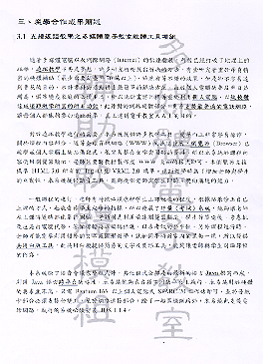
Transaction Tracking
Watermarks recording the recipient in each legal sale or distribution of the work.
If the work is misused (leaked to the press or illegally distributed), the owner could find out who is the traitor.
Visible watermarking is often adopted in this application, but Invisible watermark is even better
Notes:
Example: In 1981, photographic reprints of confidential British cabinet documents are being printed in newspapers. Rumors has it that Margaret Thatcher arranged to distribute uniquely identifiable copies of documents to each of her ministers.

Slide 22
The Defunct DiVX DVD Player
The DIVX Corporation sold a enhanced DVD player that implements a pay-per-view model.
Each player will place a unique watermark in the video disk it played.
Once the video disk is recorded and sold, the adversary can be tracked!
Notes:
The DIVX Corporation has ceased business due to mistakes in business model, not the watermarking technology.
Anti-DIVX movement and the DiVX:-> video format is quite interesting

Slide 23
Copy Control (I)
Encryption is the first and strongest line of defense against illegal copy
  Overcome an encryption mechanism
    Decrypt a copy without a valid key
      Theoretically infeasible for a well designed system
    Obtain a valid key
      Reverse-engineering hardware or software
      E.g. the DeCSS program against the CSS protecting DVD
    Legally obtain a key and pirate the decrypted content
      The central weakness of cryptographic protection!
      The content must be decrypted before it is used, but all protection is lost once decrypted!
Notes:
The Content Scrambling System is adopted in the DVD. Without a correct key, only scrambled video can be played.

Slide 24
Copy Control (II)
Watermarking in copy control
  Combining every content recorder with a watermark detector
  When a copy-prohibit watermark is detected, the recording device will refuse to copy
  The system has been envisioned by CPTWG and SDMI to protect DVD and audio

Slide 25
Copy Control (III)
Problems of adopting watermarking module in recording devices
  Increasing cost
  Reducing the value of devices
Solution
  Include the requirement for a watermark detector in the patent license of CSS instead of enforcing by law

Slide 26

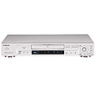


Keep Honest People Honest!
Playback control
by encryption
Copy control
by watermarking
Legal, encrypted copy
Compliant player
Compliant recorder
Non-Compliant player
Non-Compliant recorder
Illegal, decrypted copy

Slide 27
Device Control
Copy control belongs to a broader category - device control
Other applications of device control
  Automatically turning on/off functions related to special contents
    E.g Including watermark to skip advertisements
  Action toys interactive with the TV program
  Digimarc’s MediaBridge
Notes:
Automatic point browser to associative website if detect a watermark in digital camera caught images, packages, magazine advertisement

Slide 28
Properties of Watermarking
Correct detection result
  Embedding effectiveness
  False-alarm rate
Fidelity (perceptual similarity)
Resisting distortions
  Robustness
  Security
Data payload (capacity)
Blind/informed watermarking
Cost

Slide 29
Effectiveness
Effectiveness of a watermarking system
  The probability of detection after embedding
  A 100% effectiveness is desirable, but it is often not the case due to other conflict requirements, such as perceptual similarity
    E.g. watermarking system for a stock photo house

Slide 30
False-alarm Rate
Detection of watermark in a work that do not actually contain one
  The number of false positives occur in a given number of runs of watermark detector
The false alarm rate of the watermarking system used in DVD recorder should be lower than 1/10¹²
  E.g. a false alarm occurred in a world-series baseball game

Slide 31
Fidelity (Perceptual Similarity)
The fidelity of the watermarking system
  The perceptual similarity between the original and the watermarked version of the cover work
  It is the similarity at the point at which the watermarked content is provided to the customer that counts
    E.g. NTSC video or AM radio has different perceptual similarity requirements from the HDTV or DVD video and audio

Slide 32
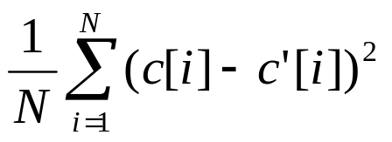
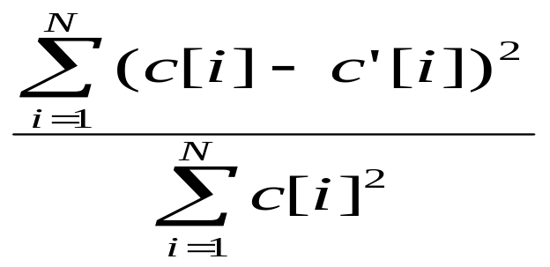
Fidelity Measures
Commonly used image similarity index
  MSE:
  SNR:
Finding a quality index completely reflecting the characteristics of the human perceptual model is difficult

Slide 33
Robustness (I)
The ability to detect the watermark after common signal processing operations
  Common images distortions
    spatial filtering, lossy compression, printing/scanning, geometric distortions
  Common video distortions
    Changes in frame rate, recording to tape…
  Common audio distortions
    temporal filtering, recording on audio tape…
Notes:
Geometry distortions is a difficult problem…

Slide 34
Robustness (II)
Not all watermarking applications require robustness to all possible signal processing operations.
There is a special class of watermarking techniques where robustness is undesirable
  The fragile watermarking

Slide 35
Security
The ability to resist hostile attacks
  Unauthorized removal
    Eliminating attacks
    Masking attacks
    Collusion attacks
  Unauthorized embedding
    Embed forgery watermarks into works that should not contain watermarks
    E.g. fragile watermarks for Authentication
  Unauthorized detection

Slide 36
Data Capacity
The number of bits a watermarking scheme encodes within a unit of time or within a work.
Different applications require different data capacities, e.g.
  4-8 bits for a 5-minutes video of copy control
  Longer messages for broadcast monitoring

Slide 37
Blind/Informed Detection
Informed watermarking schemes
  The detector requires access to the un-watermarked original
    E.g. transaction tracking,
Blind watermarking schemes
  Detectors do not require any information related to the original
    E.g.DVD copy control module
    E.g. An automatic image IPR checking robot

Slide 38
Multiple Watermarks
In certain cases, more than one watermarks are needed.
  E.g. American copyright grants the right of TV viewers to make a single copy of broadcast programs for time-shift watch. But further copies is not allowed .
    Adding two watermarks instead of alternating the original watermark to avoid the risk caused by easily changing watermarks

Slide 39
Cost
The costs in deploying watermark embedders and detectors depends on the scenario and the business model.
  Real-time constraint
    Broadcast monitoring v.s. proof of copyright
  Embedder/detector constraint
    Copy protection v.s. transaction tracking (DIV-X)

Slide 40


Models of Digital Watermarking
Viewing Watermarking As a Communication Channel
Noise
n
Output message
Input message
Watermark encoder
Watermark decoder
m
w_{a}
c_{w}
c_{wn}
w_{n}
m_{n}
c_{o}
c_{o}
Watermark key
Original coverwork
Original coverwork
Watermark
key
Geometric Interpretation for Correlation-Based Watermarking
Blind scheme
Detection region
Region of acceptable fidelity
non-blind scheme
c_{o}
c_{w}
c_{wn}
Points in the intersection
represent successfully
watermarked versions of c_{o}
w_{a}

Slide 41

Spread-Spectrum Watermarking
Watermarking Embedding
Global FFT/DCT
Embedding (+)
Inverse FFT/DCT
Watermark
(Pseudo- random sequence)
Added to perceptual significant coefficients, such as the first 1000 large transform coefficient
Watermarking Extraction
Global FFT/DCT
Reference Watermark
Correlation
Global FFT/DCT
Extracted Watermark

Slide 42


DCT-based Watermarking
Watermark Embedding
Image Analysis
Block DCT
Pseudo-Random Permutation
Embedding
Inverse DCT
Watermark Extraction
Image Analysis
Block DCT
Block DCT
Extraction (XOR)
Inverse Permutation

Slide 43

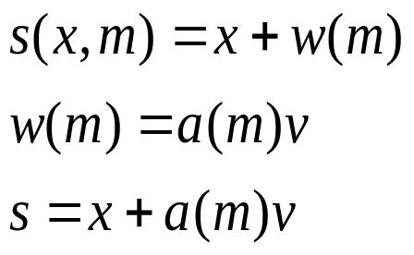
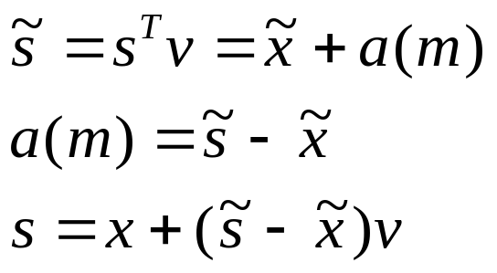


Quantization Watermarking
Host-Interference Non-rejecting Problem
a(m)v
n
x
v
Watermark Embedding with Multiple Quantizatizers
Imperceptibility ➔Shape and area of Quantization cells
Robustness ➔ minimum distance between
any reconstruction points of different quantizers
Capacity ➔ number of quantizers

Slide 44
Host-Interference Problem
In a blind watermarking scheme, the host signal may introduce interference for the detection of embedded watermark signal.
Host-interference Rejection Watermarking
Estimating the host signal in the detection side
Quantization Watermarking
  Imperceptibility
    Shape and area of Quantization cells
  Robustness
    minimum distance between any reconstruction points of different quantizers
  Capacity
    number of quantizers
Dirty-Paper Watermarking
  The embedder is told the effect of the host content
C_{o}
n
m
Embedder
Detector
w_{n}
w_{a}
C_{w}
C_{wn}
Notes:
. Q-watermarking is sensitive to scaling attack
. Dirty-paper watermarking is based on un-realistic theoretic assumption

Slide 45
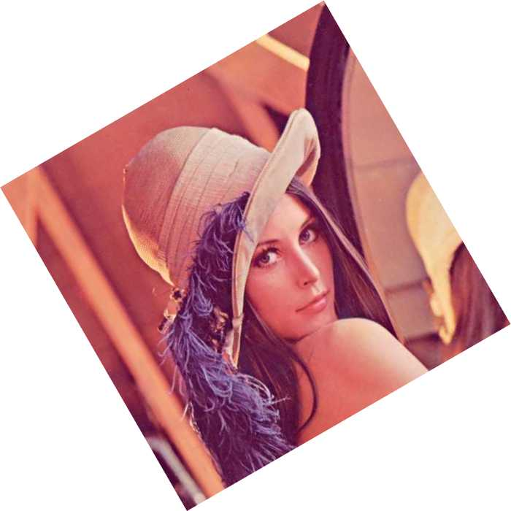



Asynchronous Attacks
…
Rotation
Scaling
Translation
Line Removal
Most existing watermarking schemes fail in face of the asynchronous attacks
  Solutions
    Non-blind schemes
      Content registration before watermark detection
    Blind schemes
      Embedding in the RST-invariant domain
      Exhaustive search
      Resynchronization through template matching

Slide 46
Watermarking Benchmarks
Stirmark
  http://www.petitcolas.net/fabien/watermarking/stirmark/
Checkmark
  http://watermarking.unige.ch/Checkmark/index.html
Optimark
  http://poseidon.csd.auth.gr/optimark/

Slide 47
Key Management Problems
Secret key
Reverse Engineering
Embedding Module
Processing/ Attacks
Extraction Module
Original Content
Embedded Content
Embedded Content
Original Content
Comparison
Watermark to Embed
Extracted Watermark
Most watermarking schemes employ a shared key between
watermark embedder and detector
  All detectors share a single private key
  It’s naïve to assume that these keys will remain secret for long
  in an adversary environment
Public-key watermarking schemes have been proposed.

Slide 48





Lossless Data Hiding
Lossless watermarking is also named as reversible watermarking or invertible watermarking
In certain applications, it is desired to reverse the marked media back to the original cover media after the hidden data is retrieved.
Proposed approach
  Reversible visible watermarking
  Losslessly compressing bit-planes to leave space for data embedding
  Modulo-addition based scheme
  Integer Wavelet Transform based scheme
  Difference expansion based scheme
Achieving high capacity while maintaining the fidelity constraint

Slide 49
Digital Fingerprinting
0010000100010011
0010000100010001
0010000100000001
00100001000?00?1
0010000100000011
Fingerprinting
  Watermarking different copies with an unique fingerprint signal to deter pirates from distributing illegal copies
  Fingerprinting code (codebook design + tracing algorithm) + Watermarking scheme
Attacks on the fingerprinted media
  Unintentional and intentional single user attacks
  Collusion attack
    A malicious coalition of users combine their code-words to produce a new codeword so that it cannot be traced back to the coalition.
Fingerprinting in a broadcast channel

Slide 50
Cryptography in DRM

Slide 51
Terminology
Scenario
  A sender wants to sent a message to a receiver securely, that is, to make sure an eavesdropper cannot read the message
Messages and Encryption
  Plaintext: the message
  Ciphertext: the encrypted message
  Encryption: disguising a message to hide its substance
  Decryption: turning ciphertext back into plaintext
Plaintext
Ciphertext
Plaintext
Encryption
Decryption

Slide 52
Mathematical Notations
Symbols
  Plaintext: M (for message) or P (for plaintext)
  Ciphertext: C
  Encryption function: E
  Decryption function: D
Formulations
  E(M)=C, the encryption function operates on plaintext to produce ciphertext
  D(C)=M, the decryption function operates on ciphertext to produce plaintext
  D(E(M))=M, the equality must hold in order to recover the original identity

Slide 53
Goals of Cryptography
Confidentiality
Authentication
  Receiver must be able to ascertain the message’s origin
Integrity
  Receiver shall be able to verify that the message is not modified in transit
Non-repudiation
  Sender should not be able to falsely deny later that he had sent a message

Slide 54
Restricted Algorithms
Basics of Restricted Algorithms
  The security of an algorithm is based on keeping the way that algorithm works a secret
  Of historical interests only, inadequate in today’s applications
    Frequent changes of algorithm due to user-leaving
    Difficult to test the security of adopted algorithms
  Widely used in low-security applications

Slide 55
Keys and Algorithms
Modern cryptography solves the problems of restricted algorithms with key (or keys), usually denoted by K
The key may be any one of a large number of values
The range of possible values of the key is called the keyspace
All of the security in these algorithms is based in the keys; none is based in the details of the algorithm

Slide 56
Cryptosystem
A cryptosystem is composed of
  An algorithm
  All possible plaintexts
  All possible ciphertexts
  All keys

Slide 57
Encryption/Decryption with Keys
Both encryption and decryption operations use the same key
Different encryption and decryption keys are used
E_{K}(M)=C D_{K}(C)=M D_{K}(E_{K}(M))=M
Key
Key
Plaintext
Ciphertext
Plaintext
Encryption
Decryption
E_{K1} (M)=C D_{K2} (C)=M D_{K2}(E_{K1}(M))=M
Encryption Key
Decryption Key
Plaintext
Ciphertext
Plaintext
Encryption
Decryption

Slide 58
Symmetric Algorithms
Symmetric Algorithms (Conventional Algorithms)
  Algorithms where the encryption key can be calculated from the decryption key and vice versa
    In most symmetric algorithms, the encryption key and the decryption key are the same
  Categories
    Stream algorithms
    Block algorithms

Slide 59
Asymmetric Algorithms
Asymmetric Algorithms (Public-key Algorithms)
  The key used for encryption is different from the key used for decryption
  The decryption key cannot be calculated from the encryption key
  The encryption key can be made public (public key)
  The decryption key (private key)

Slide 60
Cryptanalysis
Overview of cryptanalysis
  The science of recovering the plaintext of a message without access to the key
  Successful cryptanalysis may recover
    The plaintext
    The key
    Weakness in a cryptosystem that eventually lead to the results above

Slide 61
Cryptanalytic Attacks
Basic Assumptions
  The secrecy must reside entirely in the key
  The cryptanalyst has complete knowledge of the encryption algorithms used
General types of cryptanalytic attacks
  Ciphertext-only attack
  Known-plaintext attack
  Chosen-plaintext attack
  Adaptive-chosen-plaintext attack
  Chosen-ciphertext attack
  Rubber-hose cryptanalysis

Slide 62


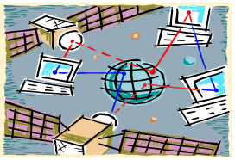
Selective Encryption
Media
Compression
System
Coefficient
Selection
Selected
Coefficients
Encryption
Coefficients
Non-selected & Non-encrypted
Coefficients
Selected & Encrypted
Coefficients
Digitalized audio/visual data
Storage or Network
Media
Decompression
System
Coefficients
Coefficient
Gathering
Selected
Coefficients
Decryption
Digitalized audio/visual data
To meet real-time constraint for audio and video multimedia playback, selective encryption techniques have been proposed
Simple symmetric cryptographic modules are adopted, such as DES or AES
Coefficients to be encrypted
  Header information
  Significant transform coefficients
  Motion vectors
  VLC tables

Slide 63





Practical Implementations
The most common implementation solution is to combine symmetric key cryptosystems with public key cryptography; namely to overcome the problems related to applying the symmetric key encryption only
  The plaintext is encrypted using a fast symmetric key scheme
  The secret key used for symmetric encryption is encrypted with slow public key scheme
Public key
A/V Data Packet
…
A/V Data Packet
A/V Data Packet
Secret key
Private key
Network
Storage
Secret key
Distributor
A/V Data Unit
…
A/V Data Unit
A/V Data Unit
User
:private-key encryption protected
:public-key encryption protected

Slide 64



Broadcast Encryption
N: the set of all users
R: the set of revoked users
S₁,…S_{m}: partition of disjoint subsets of users in N-R
K: session key
M: message
E, F: encryption function
D: decryption function
Encryption
  Ciphertext
    <[i₁, i₂,…,i_{m},E_{L1}(K), E_{L2}(K),…,E_{lm}(K)], F_{K}(M)>
Decryption
  Each user u can deduce the key L_{j} from assigned private information if u belongs to S_{j}
  Compute D_{Lj} to obtain K, and in turn obtains M
…
…
The center provides the users with prearranged keys when they join the system
At some time, the center wish to broadcast a message (e.g. a key to decipher a video clip) to a dynamic changing privileged subset of the users only

Slide 65
Digital Rights Language

Slide 66




MPEG REL
The MPEG-21 Rights Expression Language
  International Standard ISO/IEC 21000-5:2004
  With core architecture and base technology based on XrML 2.0
  Defined using XML Schema and Namespace Recommendations
license
grant
issuer
grant
Standard Extension
Content Extension
Future Extension
principle
right
resource
condition
Core
principle
right
resource
condition
Profiling

Slide 67
Important DRM-related Standards

Slide 68
MPEG-21
In 2002 June, MPEG (ISO/IEC JTC1 SC29 WG11) started working on the definition of enabling normative technology for the multimedia applications of the 21st century: MPEG-21 “Multimedia Framework”
  To enable transparent and augmented use of multimedia resources across a wide range of networks and devices
  To support transparent and highly automated transactions, especially taking in account
    Digital rights management (DRM) requirements
    Multimedia access and delivery using heterogeneous networks and terminals

Slide 69
Digital Rights Management
The desire to achieve interoperability may be in violation with the requirement to protect the value of the content and the rights of the rights holders
  DRM systems can go against the very goal of interoperability if they use non-standardized protection mechanism
  To realize an open multimedia infrastructure, more interoperability in DRM systems are crucial
IPMP in MPEG series
  MPEG-4 describes a set of standard interfaces to proprietary intellectual property management and protection (IPMP) systems
  IPMP is at the very core of the MPEG-21 specifications

Slide 70
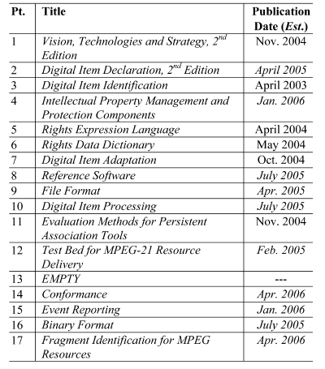
MPEG-21: Multimedia Framework
In 2000 June, MPEG (ISO/IEC JTC1 SC29 WG11) started working on the definition of enabling normative technology for the multimedia applications of the 21st century: MPEG-21 “Multimedia Framework”
  To enable transparent and augmented use of multimedia resources across a wide range of networks and devices
  To support transparent and highly automated transactions, especially taking in account
    Digital rights management (DRM) requirements
    Multimedia access and delivery using heterogeneous networks and terminals

Slide 71
MPEG-21 Part 4: IPMP
Missing IPMP Tools
Content
IPMP Tool List
IPMP Tool Manager
IPMP Tool ID(s)
Alternate IPMP Tool ID(s)
Terminal
Message Router
Parametric Tool Description(s)
Terminal-Tool Message
Interchange Interface
IPMP Tool Elementary Stream
IPMP Information
IPMP Tool 1
IPMP Tool n
M-interoperability
IPMP Tools from different vendors will be able to integrate into the same Terminal implementation concurrently
An IPMP System is able to comprise IPMP Tools made by one or more vendors
Goal: to simplify the design of tool and terminal interfaces such that
the integration and interoperation of these tools and terminals may be
more widespread and economical
C-interoperability
The major focus of MPEG in general
A consumer centric approach
Content protected by one IPMP vendor will play on any given Terminal

Slide 72
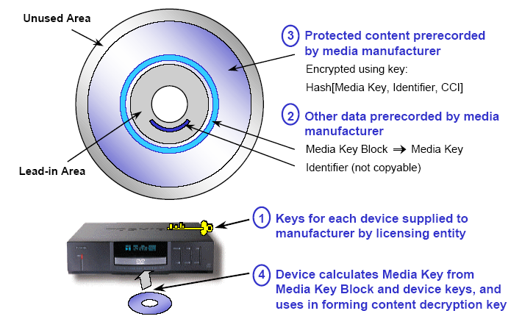
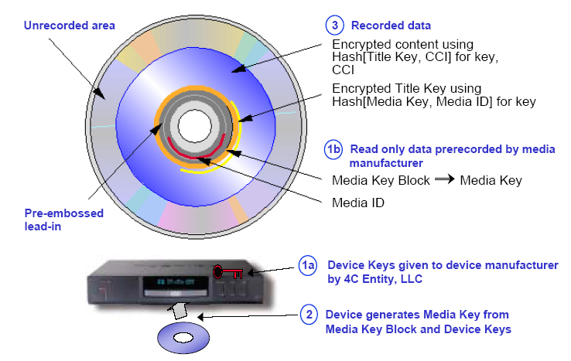
CPPM/CPRM
Media Key Block
Characteristics of CPPM/CPRM
Renewing protection settings without online or offline updating
Each device owns a set of unique keys (based on broadcast encryption theories)
Block ciphers based on Feistel networks are adopted for patents and efficiency
Adopted from the CPPM/CPRM Specifications

Slide 73
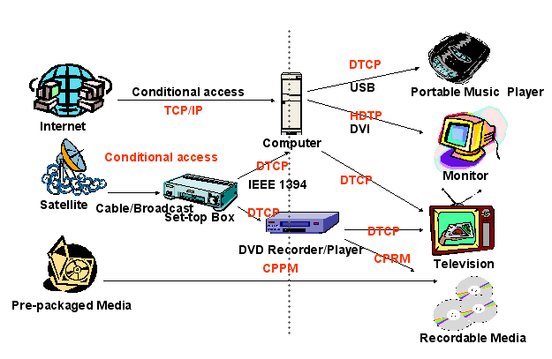

End-To-End Content Protection
End-to-end Protection throughout the Content Value Chain
Licenses of Cryptographic Tools Hook Everything Together
Decryption
Technology
License
…must adhere to CMI….
Content
Encrypted

Slide 74
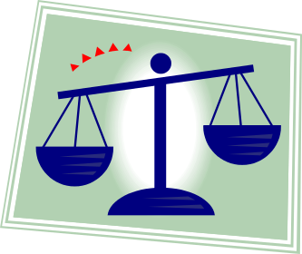
DRM-related
Legislative Issues
Adopted from Digital Rights Management Business and Technology
Chapter 3: Help from the government: Law and Technology

Slide 75
Laws and DRM
Definition of the term “Rights”
“an interest or title in an object of property;
a just and legal claim to hold, use, and enjoy it or convey it or donate it”
- Black’s Law Dictionary
Laws are what provide us all with DRM business opportunities.
The rights that content providers seek to manage in DRM are creations of the law, and no such right is inherent or self-evident.

Slide 76
Intellectual Properties
Four basic types of intellectual properties
  Patents
  Trademarks
  Trade secrets
  Copyrights
    Central to DRM

Slide 77
Patents
Patents protect novel and unique inventions or processes.
  After you patent your invention, nobody can use it without your permission, and you have essentially unlimited monopoly for a period of years
  The details of your invention will be disclosed to the world
  After the patent time expires, anyone can freely use your invention

Slide 78




Patents (cont.)
The limited time frame provides you with an incentive to create new inventions, and the time limit also ensures that everybody can benefit from your inventions in the long run.
Pharmaceutical companies offer a great example of how patents work in the real world.

Slide 79
Patents and DRM
Patents are not generally the object of DRM systems and applications.
However, patent rights do play an important role in the creation of DRM systems and applications
Patent Pool: technology companies pool their various patents and agree to reasonable licenses
Vision of MPEG-21: a multimedia framework to enable the transparent and augmented use of multimedia resources across a wide range of networks and devices used by different communities
Notes:
Access to certain copyrighted material can be conditioned upon a vendor having certain patent rights for a system. The function of system can be simply to render the copyright work
Access to certain copyrighted material can be conditioned upon a vendor having certain rights for a system, which can be simply to render the copyrighted art

Slide 80
Trademarks
Trademarks protects logos, trade names, and symbols used to identify a company’s products or services, which could be sounds and smells in addition to graphical symbols.
The strength of a trademark lies in the answer to the question ”What association does the trademark generate in a consumer’s mind?”
The licensing of trademarks is more close to rights sales, and is less suited to the application of DRM technology.

Slide 81
Trade Secrets
Trade secrets may consist of any formula, pattern, device of compilation of information which is used in one’s business and which gives a person an opportunity t obtain an advantage over competitors who do not know or use it….”
Trade secrets usually occurs within companies that are not primarily content providers, but they manifest themselves in digital information.
  Thus DRM vendors have begun to build systems that control access to documents and emails.

Slide 82
Copyrights
Copyrights are central to DRM
  What you heard about stolen music and streaming video are all related with infringement of somebody’s copyright
A copyrighted work must be
  An original work of ownership
    One who copies another’s original works does not own copyrights, but authors of independent and identical works do
  Fixed in a tangible medium of expression
  Able to be reproduced or otherwise communicated
    Silly examples: books inscribed on the Jupiter or on a electron

Slide 83
Copyrights and DRM
The essence of DRM involves these questions
  Whose copyrights are being abused?
  Whose copyrights may be abused?
  How can we prevent that?
  How can we facilitate the use of such copyrights so that the owner gets paid and the users get access?

Slide 84
Balance of Interests
“…The primary objective in conferring the copyright monopoly lies in the general benefit derived by the public from the labors of authors and their agents. It is said that reward to the author or artist serves to induce release to the public of the products of his creative genius…”
- Sony Corporation v. Universal City Studio, 464 US 416, 428
The primary intent of copyright is to increase and not to impede the harvest of knowledge
Those seeking to profit from DRM systems should keep in mind that their enrichment is not the primary consideration of the law.

Slide 85
Benefits of Copyright Law
For a certain number of years , copyright holder has the exclusive right to
  Reproduce the work
  Modify the work by creating new work based on the old work
  Distribute the work
  Perform the work publicly
  Display the work publicly

Slide 86
Registering Copyrights
Copyright arises upon creation, and registration is not required to a copyright to be considered valid.
Why bother to register copyrights?
  To recover monetary damages in any action that you bring against an infringer for your copyright, registration is necessary
The registration system is now inadequate for automatic electronic registrations and needs an overhaul
DRM systems shall take copyright identification and registration into consideration
The Copyright Office: http://www.loc.gov/copyright/

Slide 87
Types of Copyrighted Works
Literal Works
  Including book, manuscript, online work, pamphlet, poetry, report, test, automated database, computer program, or other text
Visual Arts works
  Pictorial, graphic, or sculptural work, including 2-dimensional and 3-dimensional work of fine, graphic, and applied art. Also, register architectural work
Performing Arts Works
  Musical work, dramatic work, script, pantomime, choreography, motion picture, or other audiovisual work
Sound Recording
  Register your recording of music, drama, or a lecture
Serials and Periodicals
  Register your recording of music, drama, or a lecture
Mask Works
  This protection relates to integrated circuits on a semiconductor chip

Slide 88
Fair Use
Fair use is one of the limitations on the exclusive rights of copyright
  The fair use of a copyrighted work is not a infringement of copyright
  It is a defense to an allegation of copyright infringement
  Example
    Small-amount usage for educational purpose
  Not belonging to fair use
    Substantial usage, commercial purpose, measurable market effect…

Slide 89
Fair Use Factors
The purpose and character of the use
The nature of the copyrighted work
The amount of the taking
The effect of the market value of the copyrighted work
Fair use can be regarded as one of the examples that copyright seeks to preserve the balance between the copyright owner and work users.

Slide 90
Fair Use in DRM?
Can fair use survive DRM systems?
  Positive opinion
    As long as the rights specification language is detailed enough, all possible uses of content can be listed and thus fair use can provided
  Negative opinion
    Fair use can only be judged case by case, and cannot be objectively defined in advance
    Consumers can easily throw away their fair-use rights by agreeing end user license agreement

Slide 91
First Sale Doctrine
The First Sale Doctrine said that one can apply his first sale rights to the specific copy he bought
The First Sale Doctrine with respect to record and computer software rentals is limited by the US congress

Slide 92
First Sale Doctrine in DRM?
Most electrical media are now supplied under license, instead of being sold.
  Consumers can easily give up their first sale doctrine rights by agreeing to certain contract.
  Example:
    Can you sell or license a legal copy of Microsoft Windows XP to others?
  Rights protected by copyright laws are supplanted by a commercial agreement
DRM systems protect the freedom to contract, but disrupt the balance that copyright laws want to strike

Slide 93
Characteristics of Licenses and Purchasing
EULA (End-User License Agreement)
Copyright protection technology
  Transferability
Format migration
  Continuing access
Decomposition of works

Slide 94
Important Legislation
The Uniform Information Transactions Act
The Digital Millennium Copyright Act
The Electronic Signature Act
The European Copyright Directive

Slide 95
The Uniform Information Transactions Act (UCITA)
The sale of tangible goods is generally governed by a set of laws in the U.S. known as Uniform Commercial Code (UCC)
  Whether UCC governs software is not clear
UCITA is a contract law that will provide a clear body of law for software and information license transactions.
Arguments between licensors and licensees are still unsolved
UCITA Online: www.ucitaonline.com

Slide 96







DRM-related Legislative Concerns
Basics about DMCA (Digital Millennium Copyright Act)
  Signed into law by U. S. President Clinton on October 28, 1998, is one of the response to the requirements in two World Intellectual Property Organizations (WIPO) treaties.
  The anti-circumvention provision is the most controversial part of DMCA since it prohibits making or selling devices or services that circumvent technological measure used to protect copyrighted works
  Exception to Anti-Circumvention Provision:
Government activities
Decision making of
educational institutes
Reverse-engineering for
program interoperability
Encryption
researches
User privacy
protection
System security
testing
Protection for accessing Internet by minors

Slide 97
The Electronic Signatures Act
President Clinton signed into law the Electronic Signature Act in June 2000.
Parties can sign checks and apply for loans without a signature on paper.
  Contracts are legally effective in electronic form
An important building block for DRM systems

